Slide 1
9. File Systems & I/O Systems
Course Exercise in Operating System
Email：wangfengyu@sdu.edu.cn

Slide 2
Outline
File systems
  File concept & access methods
  Directory structure
File system implementation
  Disk space allocation
  Free space management
I/O systems (quick review)
Shandong University

Slide 3
File concept & access methods
File system: Organization of non-volatile memory
  Allow user to create, maintain, access, modify and delete files.
Data is regarded as a set of files
  file is an abstraction of storage unit containing
    a logical set of data
    descriptive information about the file (attributes)
Files are grouped into directories
  enable file identification & retrieval
Shandong University

Slide 4
File concept & access methods
File Structure：Consists of a number of records
  a record is the finest granularity for accessing data
    can be a “byte” or a “complicated object”
File Attributes: Used to simplify file identification and access
  name
  type: e.g. executable module, ASCII text, ...
  location: pointer to where the data is stored
  size
  protection: e.g. read/write privileges
  time & dates: e.g. of creation, last modification & use
  user: “owner” of file
Shandong University

Slide 5
File concept & access methods
File Operations
  Create and Delete
    allocate and deallocate space
    add/delete the file to/from the directory
  Open and Close
    reduce directory searching
    open
      locates a file in the directory structure
      stores this information in the OS open file table
      returns a handle to the file
      usable for reads, writes, etc.
    close
      removes the file table entry
Shandong University

Slide 6
File concept & access methods
File Operations
  Read, Write, and Reposition
    depends on the file structure
    sequential operations
      OS maintains a file position pointer
      read reads from this position
      write overwrites starting at this position
      reposition changes the file position pointer
  Other operations
    Append to an existing file
    Copy a file
Shandong University

Slide 7
File concept & access methods
File Types
  Provide means of interpreting file contents
    can be left completely to the application program
    OS typically provides support for a minimal set of types
  Three ways of associating file types
    OS maintains file type information
      e.g. Unix executable which indicates a binary object module
    names indicate types
      typically expressed via an extension (e.g. file-name.type)
      convenient for user and application programs
      OS can associate programs with file extensions (e.g., Word with .doc)
    internal to the file
      e.g. a magic numbers convention
Shandong University

Slide 8
File concept & access methods
File Storage and Access Models
  Files are stored in (persistent) secondary storage
    Stored as data chunks called blocks
      Sectors on disks
    Blocks are usually fixed size
  File access models
    sequential: read/write (fid, buf)
    direct: read/write (fid, record#, buf)
    indexed: read/write (fid, record-key, buf)
Shandong University
Notes:
扇區是磁盤最小的操作單元，每次讀寫字節數必須是一個扇區的整數倍；塊應該是邏輯上的概念，由操作系統定義的，它的大小是一個扇區的整數倍

Slide 9
Outline
File systems
  File concept & access methods
  Directory structure
File system implementation
  Disk space allocation
  Free space management
I/O systems (quick review)
Shandong University

Slide 10
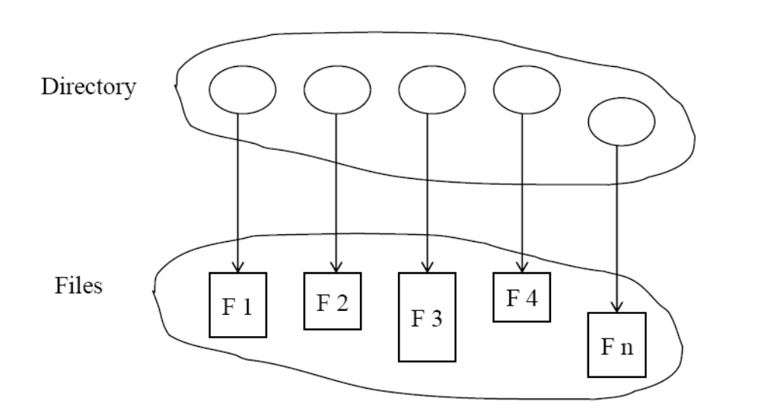
Directory structure
Directories
  A logical way of organizing the files
    a “symbol table” for translating file names into its attributes
    to expedite access to files
    to implement access privileges easily
Shandong University
Notes:
Expedite 加速完成

Slide 11
Directory structure
Tree-structured Directories
  The directory is a tree of unlimited depth
    each node is either a file or a (sub)directory
    each file/directory is identified by a path-name
      from the root (an absolute pathname)
      from a specified directory (a relative pathname)
  Protection information specified at each node in the path
    for files: readable, writeable, executable
    for directories: visible, writeable, searchable
    UNIX scheme:
      Three fields (each with three bits): owner, group, others
      drwxr-xr-x 2 vijayk None 0 Apr 8 13:03 adirectory
      -rw-r--r-- 1 vijayk None 0 Apr 8 13:03 afile
Shandong University
Notes:
画tree图说明 路径（仍有学生不明白相对路径的写法）

Slide 12
Directory structure
Non-tree Directory Structures
  Limitations of tree-structured directories:
    Restricted file sharing
      each file has a single name and belongs in a single directory
  Generalizations of trees
    directed acyclic graphs (DAGs)
    (unrestricted) directed graphs
  Basic idea
    allow a file or directory to be in multiple directories
Shandong University

Slide 13
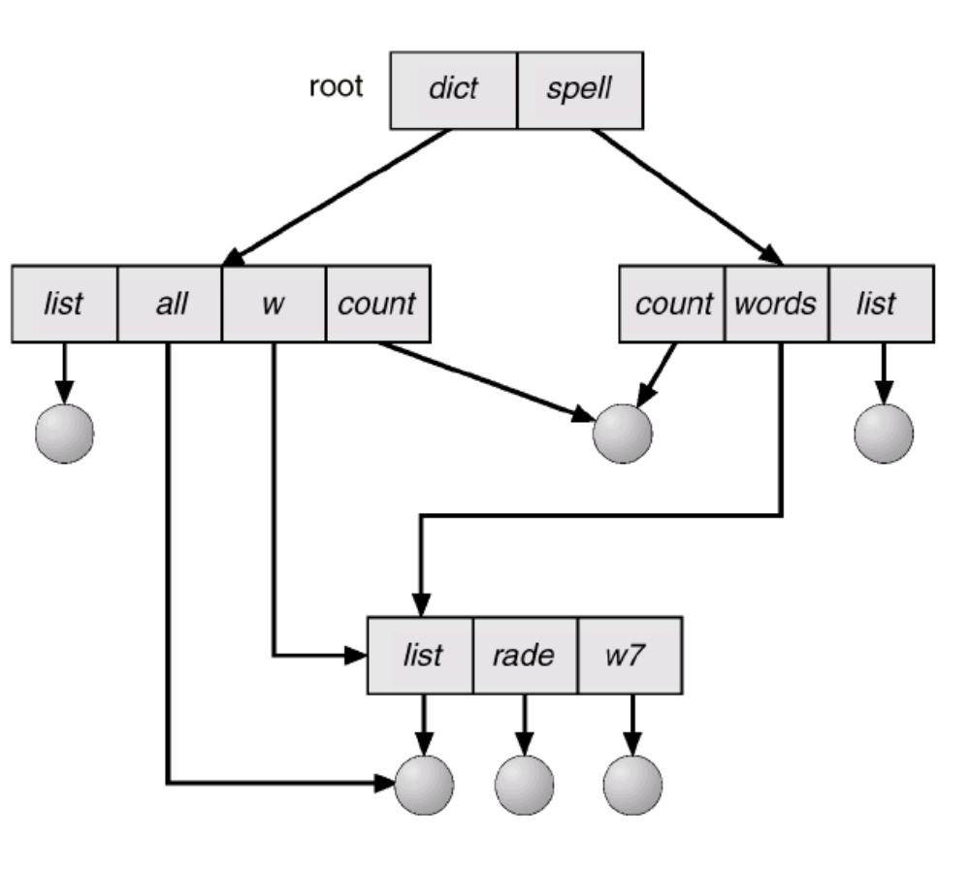
Directory structure
Non-tree Structured Directories: Example
Shandong University

Slide 14
Directory structure
Problem
  The same file may be referred to by multiple names
    How do we maintain consistency of the directory information?
      E.g., file size, update time, etc.
Two approaches
  Maintain a single copy of the file
    each parent directory contains pointers，called links in Unix
      hard links: a new (replicated) directory entry
        OS keeps these entries consistent
      soft links: a directory entry that points to the original
    pointers must be transparent to application programs
  Maintain explicit copies
    OS must update all copies to reflect the latest state
Shandong University
Notes:
画图说明Hard link 和 soft link。
Hard link 和 soft link的区 别：硬链接原文件＆链接文件公用一个inode号，说明他们是同一个文件，而软链接原文件＆链接文件拥有不同的inode号，表明他们是两个不同的文件； 在文件属性上软链接明确写出了是链接文件，而硬链接没有写出来，因为在本质上硬链接文件和原文件是完全平等关系；链接数目是不一样的，软链接的链接数目不 会增加；文件大小是不一样的，硬链接文件显示的大小是跟原文件是一样的，而这里软链接显示的大小与原文件就不同了。

Slide 15
Directory structure
Other Problems
  Shared files
    problem with deleting shared files
    solutions
      leave links dangling (e.g. soft links in Unix)
        the links are checked (and generate errors) when accessed
      maintain a reference count of links to a file/directory
        delete only when count is zero (e.g., hard links in Unix)
  Directory cycles
    adding links can create cycles
      can happen unless each directory creation is checked
    problems with directory search
    solutions
      do nothing (Unix)
      make sure that directory traversal operations check for cycles
Shandong University
Notes:
traversal operations 遍历操作

Slide 16
Outline
File system interface
  File concept & access methods
  Directory structure
File system implementation
  Disk space allocation
  Free space management
  File system efficiency considerations
I/O systems (quick review)
Shandong University

Slide 17
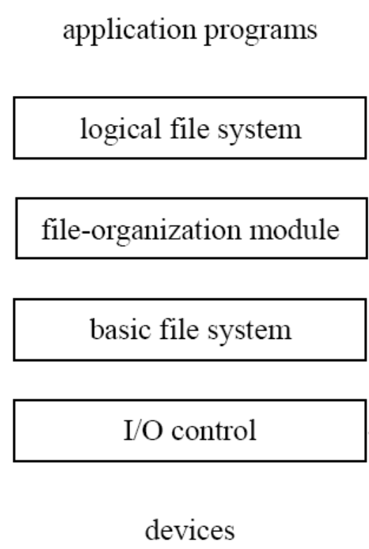
File system implementation
Overall structure
uses the directory structure to translate user file commands into requests expected by the file-organization module
[responsible for caching and other optimizations ]
deals with logical blocks and logical devices
[includes the free-space manager which tracks and allocates free disk blocks ]
deals with blocks and physical devices: [issues commands to the device drivers]
device drivers and interrupt handlers to transfer information between memory and the disk system
Shandong University

Slide 18
Outline
File system interface
  File concept & access methods
  Directory structure
File system implementation
  Disk space allocation
  Free space management
I/O systems (quick review)
Shandong University

Slide 19
Disk space allocation
Three types of information stored on the disk
  data blocks:
  file descriptors:
    name, access privileges, usage times, ...
  storage allocation information (sometimes called a superblock)
Disk block allocation
  disk blocks are “numbered”
    usually a simple function of <platter #, surface #, cylinder #, sector #>
  sometimes allocated in multiples to reduce management overhead
  commonly used schemes
    Contiguous allocation
    Linked allocation
    Indexed allocation
Shandong University

Slide 20
Disk space allocation
Scheme 1: Contiguous Allocation
  Similar to contiguous memory allocation
    files occupy a sequence of "blocks" of disk
      a file occupies blocks b, b+1, ... b+(n-1)
    the file descriptor stores b and its length (in bytes)
    mapping from logical to physical: Logical address/Block Size
      Quotient: block number
      Remainder: block offset
  Finding disk space
    methods such as first-fit, best-fit, worst-fit
  Problems
    external fragmentation
      compaction would work but involves high-overhead disk operations
    need a good estimate of the file size at allocation time
      too small: potentially expensive copying is needed to relocate it as it grows
      too large: internal fragmentation
Shandong University

Slide 21
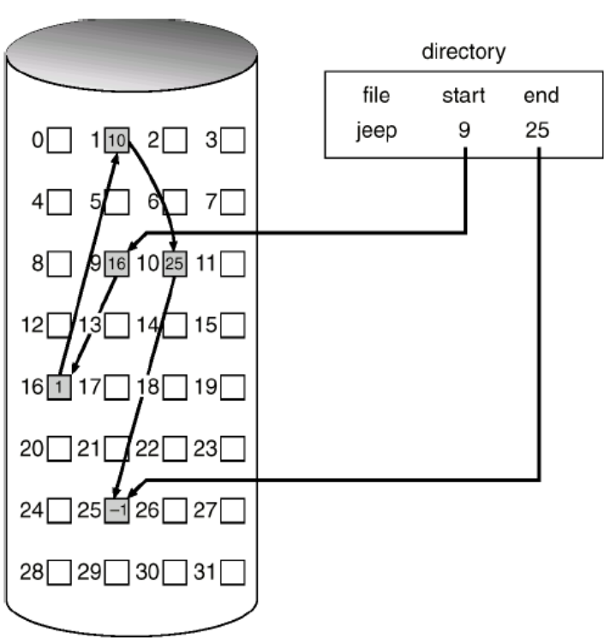
Disk space allocation
Scheme 2: Linked Allocation
  The file consists of
    arbitrary sequence of disk blocks
    a set of pointers from each block to the next
  Initially, the file descriptor
    contains a null pointer when the file is empty
  Extending the file is done by
    adding any free block
    modifying the pointers
  No problem with external fragmentation
  Where are the pointers stored?
Shandong University

Slide 22
Disk space allocation
Pointer Storage for Linked Allocation
  Store the pointer in the blocks
    very slow random/direct access
  Store the pointers separately
    e.g. MSDOS File Allocation Table (FAT)
      uses a contiguous array A of indices (stored in a fixed place on the disk)
      if block i is followed by block j in a file， A[i] = j
      array A can be stored in memory during use
        or partially stored (cached)
      allows (slow) random access to file by scanning array
Shandong University

Slide 23
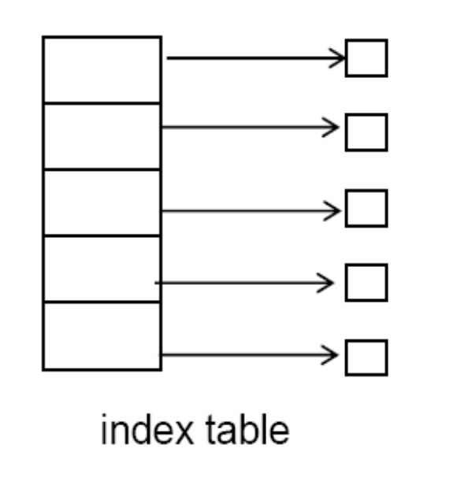
Disk space allocation
Scheme 3: Indexed Allocation
  Each file has an index table A
    The i ^{th} block of the file is in block A[i]
    can be cached for rapid access
  Pros
    supports direct access
    has no external fragmentation
  Cons
    for small files, index block space may be wasted
Shandong University

Slide 24
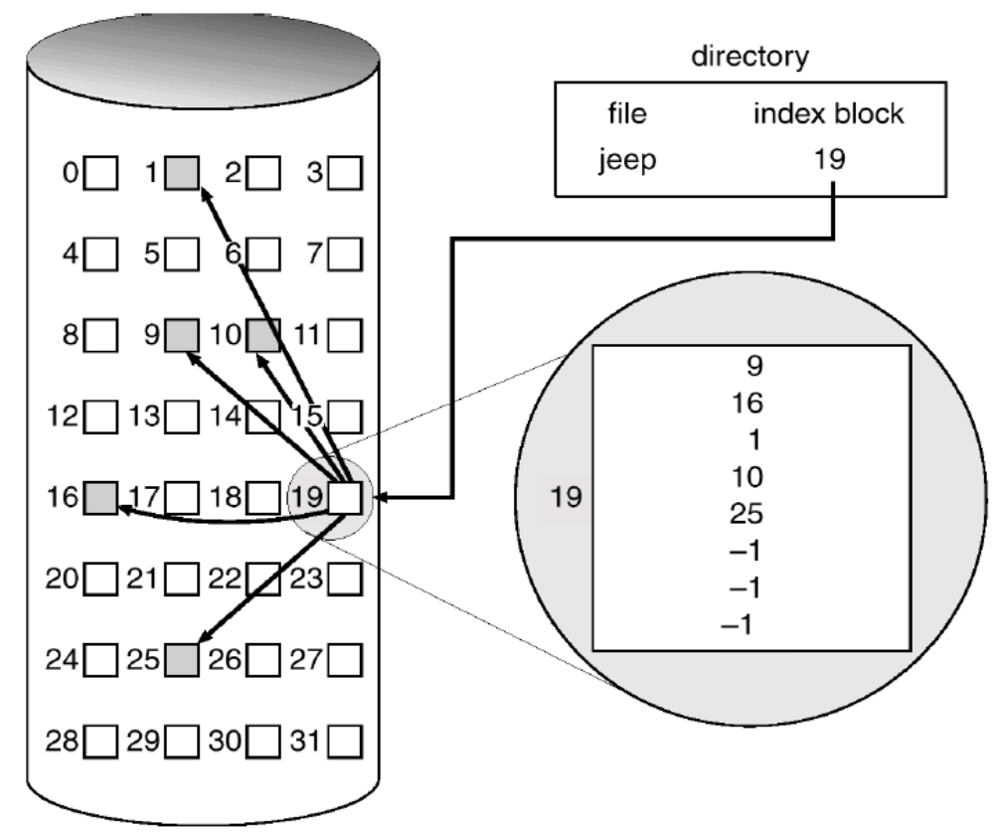
Disk space allocation
Example of Indexed Allocation
Shandong University

Slide 25
Outline
File system interface
  File concept & access methods
  Directory structure
  Sharing file
File system implementation
  Disk space allocation
  Free space management
I/O systems (quick review)
Shandong University

Slide 26
Free-space Management
Keep track of which disk blocks are free
  should be fast
Bit vectors
  one bit per block: 1 means block is free; 0 means block is in use
  finding a free block
    the OS scans the vector for the first 1
    sets it to 0 upon allocation
  improvements
    some processors support special instructions
      return the offset in a word where the first 1 occurs
    circular search (start from previous position)
  bit vectors may be very large
    if maintained on disk, access is slow
Shandong University

Slide 27
Free-space Management (cont’d)
Linked lists: Connect all the available blocks
  a separate list
    the file allocation table (FAT) can do this for free
  one pointer in a free block which points to the next
    allocation & deallocation are slow
Grouping
  a linked list of free blocks full of pointers
    used in Unix
Counting
  rather than a list of blocks, maintain a count of contiguous free blocks
    point to the beginning of the "run" of free blocks and the number
  a large number of free blocks can be found quickly
    useful when allocations are done in groups
Shandong University

Slide 28
Outline
File system interface
  File concept & access methods
  Directory structure
  Sharing file
File system implementation
  Disk space allocation
  Free space management
I/O systems (quick review)
Shandong University

Slide 29
I/O systems
I/O hardware
  I/O devices sit on a bus
  Device controllers
  Controllers appear to the OS as I/O ports and associated registers
Handshaking between the host and the device controller
  Polling
  Interrupts to make efficient use of CPU resources
  Offloading of CPU work to a DMA controller for large transfers
Shandong University

Slide 30
I/O Interface
Goal: Standard, uniform treatment of I/O devices
I/O system calls encapsulate device behaviors in generic classes
Device-driver layer hides differences among I/O controllers
  Devices differ among several dimensions
    character-stream (keyboards, mice) or block (disks) or network devices
    sequential or random-access
    synchronous or asynchronous
    sharable or dedicated
    read-write, read-only, or write-only
  Device driver exports a standard interface (mapping to system calls)
    OSes typically provide a back-door to directly access device driver
    E.g., UNIX ioctl system call
Shandong University
Notes:
ioctl用于向设备发控制和配置命令，有些命令也需要读写一些数据，但这些数据是不能用read/write读写的，称为Out-of-band数据。也就是说，read/write读写的数据是in-band数据，是I/O操作的主体，而ioctl命令传送的是控制信息，其中的数据是辅助的数据。例如，在串口线上收发数据通过read/write操作，而串口的波特率、校验位、停止位通过ioctl设置，A/D转换的结果通过read读取，而A/D转换的精度和工作频率通过ioctl设置。

Slide 31
Kernel I/O Subsystem
Provides a common set of services and maintains kernel data structures
  Scheduling: I/O request ordering via per-device queue
    For performance and fairness
    e.g., disk request scheduling affects seek overheads
  Buffering: Store data in memory while transferring between devices
    to cope with device speed/device transfer size mismatch
      Double buffering permits overlap
Shandong University

Slide 32
Kernel I/O Subsystem (cont’d)
  Caching: Fast memory holding copy of data
    key to performance
    E.g., file caches
  Spooling: Merges requests for a device
    if device can serve only one request at a time (e.g., printing)
    System call interface permits multiple applications to print concurrently
      Request data is put into a common directory
      Spooler issues them one at a time to the device
  Error handling
    recovery from transient errors: e.g. reissuing a disk read request
Shandong University

Slide 33
Laboratory
Lab 4 (p49)
Shandong University

Slide 34
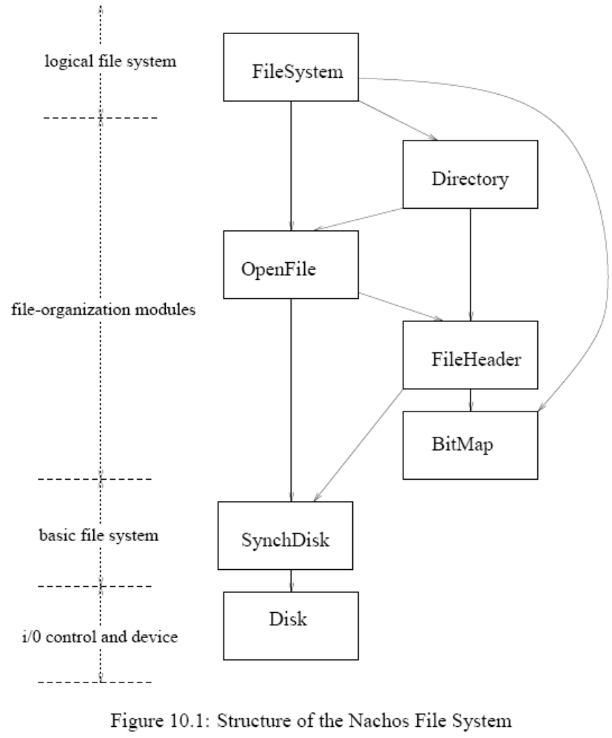
Kernel Threads and User Processes
Shandong University

